Slide 1
Simulation evaluation of Bayesian borrowing techniques in estimating biomarker cutoff for diagnosing or predicting a binary response
Supervisors: | Palash Sharma, Cathy Xie, Dachuang Cao, Maria Yu

Slide 2
Background
Determining a cutoff value for a continuous biomarker in a continuous diagnosis test to classify patient population is challenging
Most common current methods (ROC–based methods) do not provide information on the diagnostic accuracy of the test at an individual level (Vradi et al. 2018)
The learning of one study from predictive modeling for diseases/non-disease or responders/non-responders is rarely utilized in the exercise for the next study

Slide 3
Scope of Project
Explore Bayesian borrowing methods such as mixture prior (Vradi et al. 2018) and power prior, for estimating the cutoff of a continuous biomarker assay
Design adaptive strategies to select the weight parameters
Compare performance of the two priors and frequentist approach for determining cutoff
Extend the method to include multiple cut point determination

Slide 4
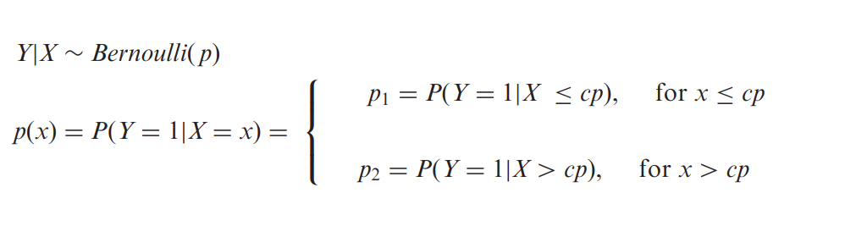
Model
The p1 = 1- NPV expresses the probability of response given X is below the cutoff value cp and p2 = PPV expresses the probability of response given that X is greater than cp

Slide 5



Model

Slide 6
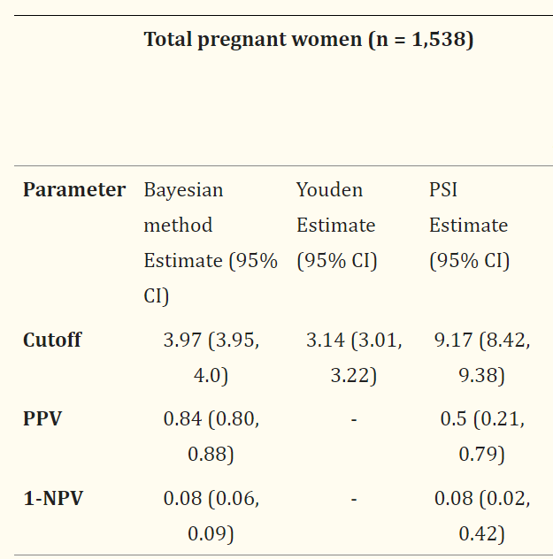
An example
Rahmati et al. (2023) :
Determination of elevated thyrotropin (TSH) cutoff for prediction of preterm-birth
Combine informative and non-informative prior with mixture prior
PPV ( positive predictive value) and NPV (negative predictive value) are clinical utility measure of a diagnostic test
Have better PPV and NPV performance compared to predictive summary index(PSI), the frequentist approach

